Slide 1

Project Review-2
(Literature Review / Applications Survey)
| Front-End Development Frameworks | | Title - Edu Craft – Online Course Builder with Video & Quiz Module | | Team Members – 2410030355-O.Harshitha, 2410030356-Srujana Sadhu, 2410030357-Ashrita Sri Gayatri V, 2410040126-A Sravani | |Guide - Ms P Sree Lakshmi Ma’am | Department – CSE|

Slide 2
Relevance to Project Title
Brief Explanation of Framework & Tool Choice Currently, we are working with Visual Studio Code (VS Code) as our primary development environment because it is fast, lightweight, and highly customizable. Its rich library of extensions, integrated terminal, and powerful debugging tools help us write and test code efficiently, even in the early stages of EduCraft’s development. VS Code’s flexibility also makes it easy to integrate future technologies such as React.js when we progress to building more interactive features.
In the future, we plan to adopt React.js for its component-based architecture, which will allow us to develop features like quizzes, videos, and previews as modular, reusable units. React’s virtual DOM will enable instant updates without reloading the page, delivering a smooth, responsive user experience.
Connection Between Literature Review and Project Goals The reviewed literature on e-learning platforms and front-end development highlights the importance of interactivity, modularity, and real-time responsiveness. These qualities will be implemented in EduCraft in stages — beginning with efficient coding in VS Code and later enhanced through React.js. Research shows that learners and content creators remain more engaged when updates are reflected instantly and interfaces are easily customizable. By transitioning from a VS Code-based workflow to React-powered modules, EduCraft will evolve into a smooth, adaptable, and efficient course-building platform.
Key References
VS Code Official Documentation – Guides on extensions, debugging, and integrated tools to boost productivity in EduCraft’s initial development phase.
React Official Documentation – For future integration, providing best practices for building reusable, modular components.
MDN Web Docs – JavaScript – Explains the language features that enable interactivity and real-time updates.

Slide 3
Depth & Quality of Literature Review
In our literature review, we analysed eight authoritative sources, including official documentation, peer-reviewed studies, and industry case examples. Research by Brito et al. (2020) and Md. Morsalin & Rahman (2022) found that React outperforms Angular and Vue in speed, component reusability, and scalability — capabilities essential for EduCraft’s modular video and quiz features. Core resources such as the React Documentation and MDN Web Docs provided the technical foundation for building dynamic, interactive learning tools. Airbnb’s adoption of React illustrates its suitability for large-scale, complex applications, while Google Web Fundamentals and W3C HTML5 standards reinforced best practices for creating fast, responsive, and accessible platforms. Collectively, these sources present a compelling case for adopting React to deliver EduCraft’s smooth, engaging, and future-ready online course experience. file:///C:/Users/Nagaraj/Downloads/JITEv15ResearchP157-190Sun2138%20(1).pdf https://research.com/education/online-education-statistics

Slide 4
Critical Analysis, Synthesis & Gap Identification
React powers Facebook & Netflix, Angular drives Google tools, and Vue supports Alibaba & Xiaomi — e-learning giants like Udemy & Coursera use similar tech for smooth, responsive learning.
1. Critical Analysis
Existing apps (Byju’s, Vedantu, Unacademy) offer video lectures, live classes, and test series.
Strong content but low personal interaction & flexibility.
High cost → less accessible for all students.
Technical issues: Lag/crash during high traffic, needs a strong internet.
2. Synthesis
Students need more than videos – handwritten notes, doubt-solving, and collaboration.
Materials are scattered → no organized revision tools.
Minimal focus on daily learning habits & mental wellness.
3. Gap Identification
No 1-to-1 or peer learning.
Weak note management & missing smart tools (mind maps, past paper analysis).
No offline mode for low-internet areas.
Systems are not crash-proof for unlimited users.
→ Edu Craft bridges these gaps with:
Crash-proof cloud system for unlimited users.
Handwritten & rough notes, mind maps, charts, roadmaps.
AI-powered personalization + gamification.
Wellness tools (Pomodoro, mindfulness).

Slide 5
Project Implementation Started
1. Initial Progress
Created the UI design for EduCraft, including the dashboard, course builder, video section, and quiz interface.
Developed key React components like the navigation bar, course creation form, and quiz module for a modular structure.
Configured routing using React Router to allow smooth navigation between pages (dashboard, editor, and learner view).
2. Frameworks, Libraries, and Tools Used
React – for building reusable and interactive components.
Tailwind CSS – for fast, responsive, and clean styling.
React Router – for seamless page navigation.
3. Expected Milestones for Next Review
Integrate video upload and playback functionality.
Build quiz creation and scoring logic.
Make the platform responsive for mobile and tablet devices.
Set up data storage for saving courses and quizzes.

Slide 6
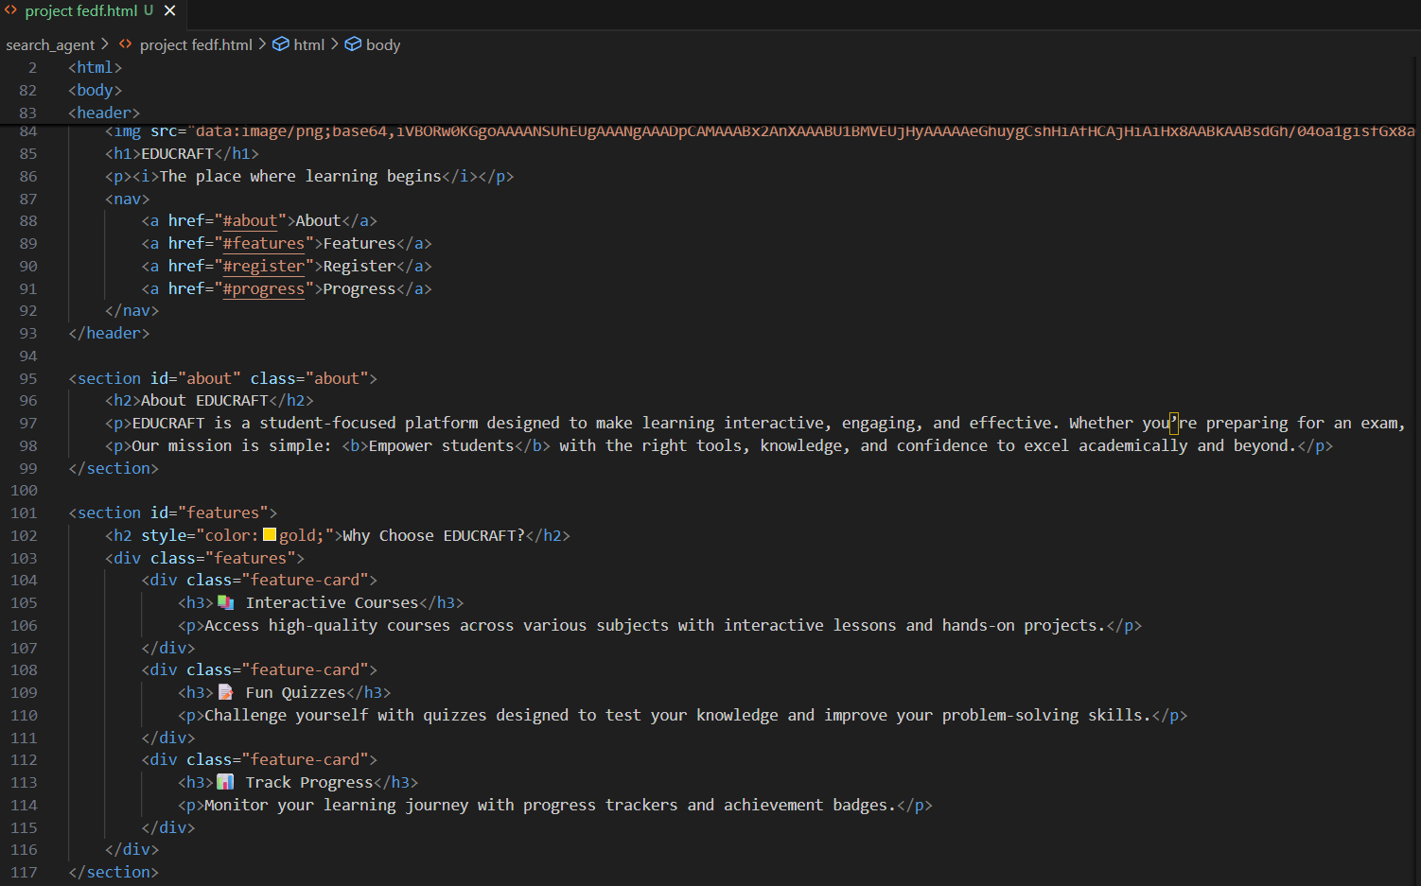
4. Screenshots / Code Snippets
http://127.0.0.1:5500/search_agent/project%20fedf.html

Slide 7
THANK YOU

